Slide 1
welcome to the CWLS
June Special Meeting
WE WILL START IN A FEW MINUTES….

Slide 2
welcome to the CWLS
June Special Meeting
Tuesday, June 14, 2022
Special Meeting to discuss Dissolving the CWLS and Joining the CSPG

Slide 3




Housekeeping
Audience will be muted throughout the session.
Comment/Question?
Use the chat function.
This meeting will be recorded for later viewing.
Follow us on LinkedIn: CWLS - Canadian Well Logging Society

Slide 4
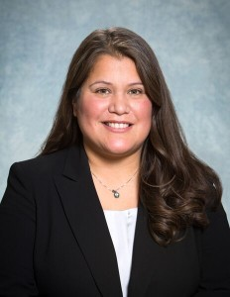
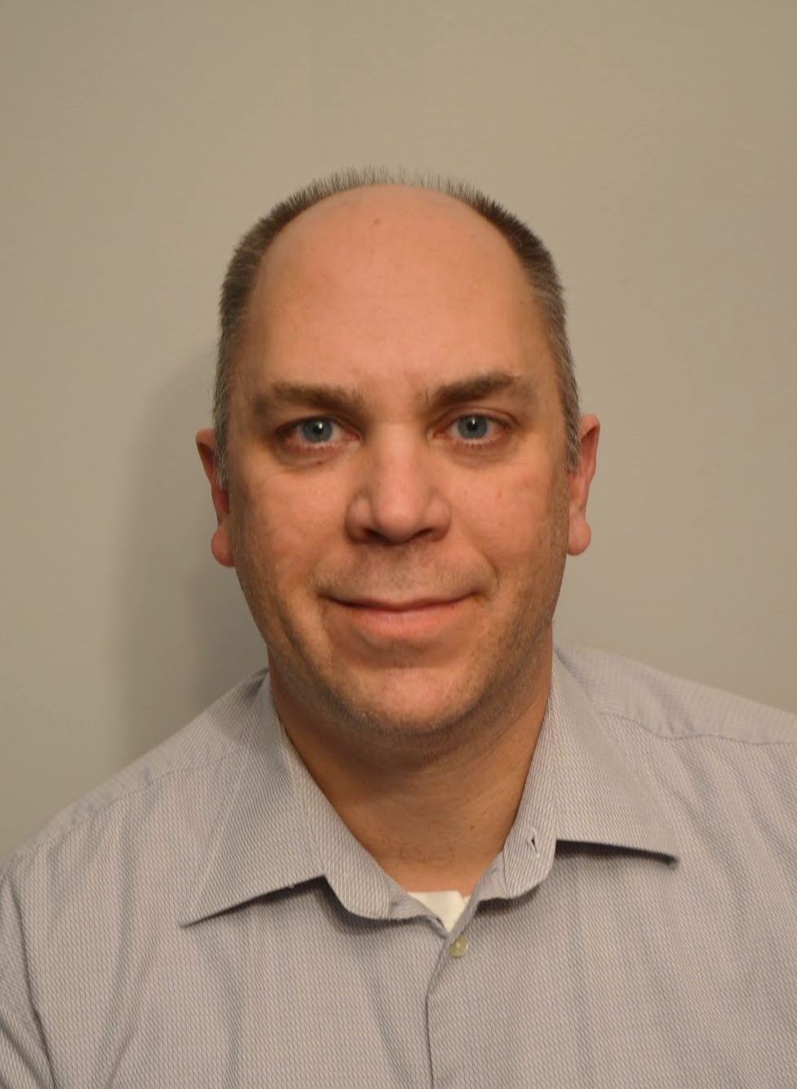
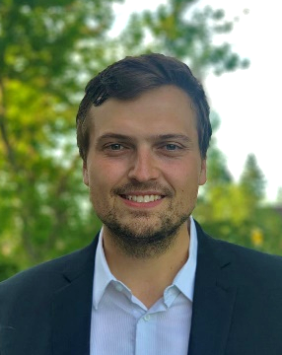
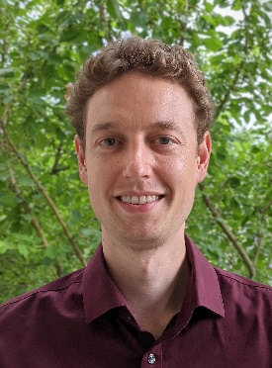
2021/2022 Executive
Kathy Diaz
President
Michael Lazorek
Vice President
Matthew Yaychuk
Website &
Publications Chair
Felix Todea
Membership &
Committees Chair
Aaron Weber
Secretary & Treasurer
Christa Williams
Past President

Slide 5
AGM – Change of date
The 2022 Annual General Meeting has been rescheduled to July 6, 2022
This event will be held at the Fairmont Palliser Hotel
5:00 – 8:00pm.
Scotch and Chocolate Tasting provided by Willow Park Wines and Spirits
CWLS historical memorabilia available for viewing
Tickets will be available online for $20 per person.
Please register at www.cwls.org

Slide 6
CWLS/CSPG Joint GeoConvention Mixer
CWLS/CSPG Joint GeoConvention Mixer
Wednesday, June 22, 2022
12:00 to 1:00
223 8th Ave SW, Calgary, AB
Second Floor
Tickets: $20/member
Tickets can be purchased through www.cspg.org/cspgcwls

Slide 7
Overview of special meeting
  Why join the CSPG?
  Why not stay the CWLS?
  Why not join the SPWLA?
  Membership Implications
  Financial Implications
  Where to get more information
  Special Ballot
  What does a yes vote mean?
  What does a no vote mean?
  What are your thoughts?

Slide 8
Discussion – CWLS to join the CSPG
The CWLS and the CSPG have been discussing ways to join the two societies to better serve the membership, exercise cost savings, increase enrollment and provide mentorship and educational opportunities.
There has been overwhelming support from the CSPG Executive and a special motion approving the MOU between the organizations has passed. This sets the stage for a member vote by the CWLS

Slide 9
Discussion – CWLS to join the CSPG
What would joining the CSPG mean?
  CWLS would cease to be a registered non-profit Alberta Society
  The CSPG would establish a Technical Division (CWLS) led by a Division Chair
    The division chair would be a CWLS member to begin with, but ultimately open to anyone
  CWLS funds would be transferred to the CSPG
    The CSPG would establish a Funds committee to determine the best use of CWLS Funds
    This would be led by volunteers (hopefully all CWLS members) but subject to CSPG guidelines
  CWLS would retain its name, logo, LinkedIn profile
  CWLS membership categories would be transferred to the CSPG. Members would have to register individually unless already part of the CSPG
  all the CWLS publications/Crain Recordings/Rw Catalog/Special Core/Atlas/Scholarships would be retained
  CWLS would function as any other Technical Division under the CSPG
  and be subject to the Bylaws of the CSPG

Slide 10
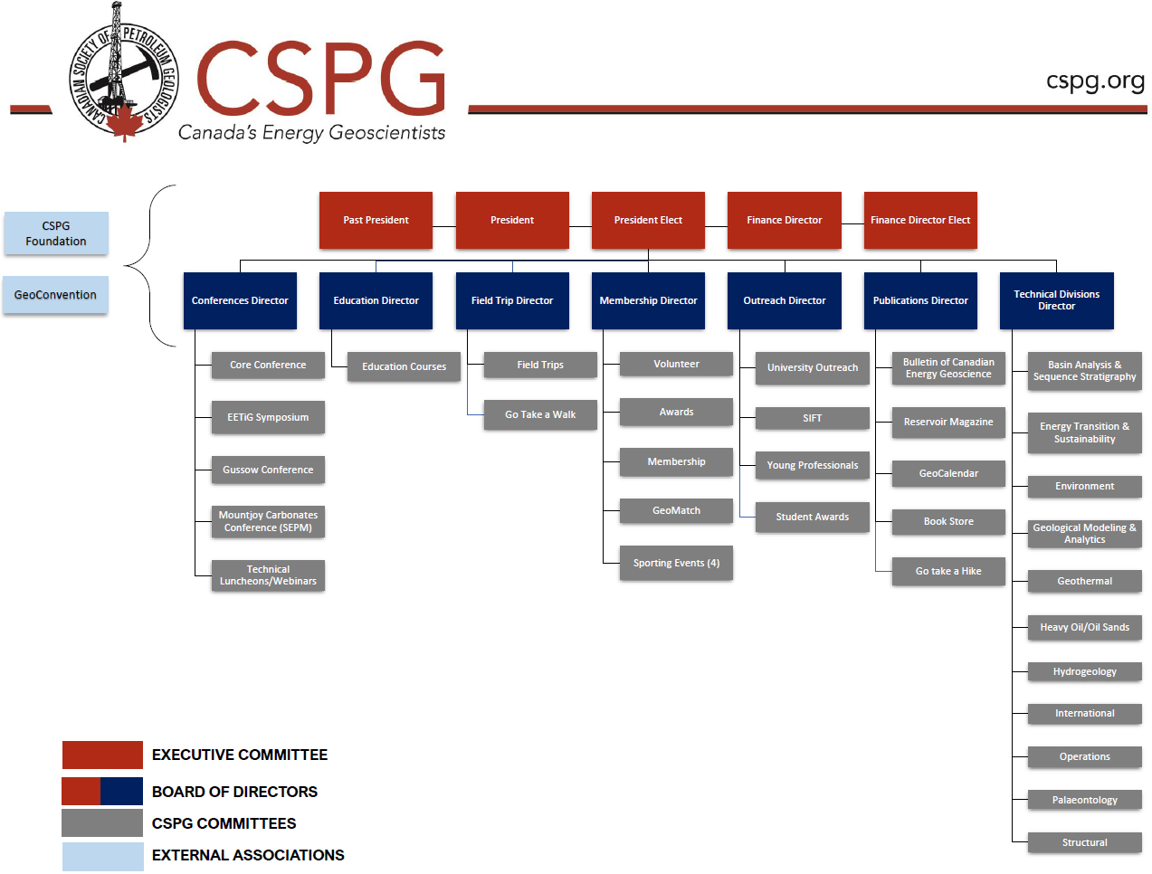
CSPG Structure
Canadian Well Logging Society

Slide 11
Why not continue as the CWLS?
CWLS has seen flat membership growth over the past number of years
While we have a very strong and active membership, the demographics are changing at the same time as the energy landscape is evolving
While we have a strong savings and investment portfolio, we have taken losses over the past years and we do not have many sources of revenue
Our share of GeoConvention proceeds has been drastically reduced due to lack of technical contributions/talks/posters and attendance
Corporate sponsorship has been hard to come by

Slide 12
Why join the cspg?
The CSPG sees the benefit of having us under their umbrella
  Current CSPG Executive Board has been a great partner in discussions and has made every accommodation possible
Canadian Society – aligned interest
Canadian Energy Landscape focus
Large organization with strong ties to local Energy and Environmental Industries
The CSPG is in a better position lead change in the energy and environmental industries.
  Petrophysics has always been a fundamental in oil and gas exploration
  But by joining with the CSPG we hope to have a far more influential role in the Energy revolution taking place and expand into the environmental sector
Many joint members already
  30% of CWLS members are CSPG members

Slide 13
Why not join spwla?
a little history 2015-2018
Original discussions on a merger with the SPWLA were positive
  Gain technical benefits and resources of SPWLA organization
  Access to papers, distinguished speakers
  Keep the CWLS as a chapter name
  Keep CWLS assets
However, a change in SPWLA Executive changed the terms of signed agreement
  In order to proceed with the merger the SPWLA wanted to
    dissolve the CWLS name
    take over all assets
  CWLS chose not to accept the new terms

Slide 14
Why not join spwla?
Benefits of Joining CSPG over the SPWLA
  legally much easier than joining an American organization
  retain control of CWLS funds
  retain control of CWLS name
  Higher chance of influencing Society – Board Members/Committee Chairs/Volunteering
  Canadian content – Energy Sector/Environmental Sector/University Scholarships
Drawbacks of Joining CSPG and not SPWLA
  much less focus on Petrophysics within society
  fewer petrophysical technical resources
  no membership access to SPWLA Journal’s, training or conferences

Slide 15
Membership implications
CWLS members* will be offered equivalent membership in the CSPG, gaining access to all the CSPG’s resources and activities while still being able to participate in all the CWLS’ activities and traditions
Current CWLS/CSPG dual memberships will only have CSPG memberships going forward
There will be a revised fee schedule for CWLS members to receive CSPG membership renewals at a reduced rate for 2 years, and afterwards will be able to renew membership at the CSPG fee schedule
Each member will be required to register as a CSPG member; membership will not be automatically transferred
*as of June 29th, 2022

Slide 16
Financial implications
Due to declining contributions from the CWLS, the CWLS stake in GeoConvention has been reduced from 10% to 3%. The joined Society will have a strong financial position in GeoConvention (60%).
All CWLS investments would be sold and all funds would be transferred “as-cash” to the CSPG to be dispersed as set out in the MOU at a later date
As part of the CSPG, we will endeavor to use a significant portion of the current CWLS assets to continue to provide petrophysical specific content and digitize legacy documents that are not currently available.
Funds may be transferred to the CSPG Foundation Trust – non-profit external body that distributes funds for educational purposes.
  Funds can be purposed to provide petrophysical opportunities but are subject to the fund’s deed.
$80,000 trust has been established for Petrophysical educational scholarships (details/criteria have not been determined)
Winston Karel Petrophysical Scholarships will continue to be offered at the discretion of the benefactor

Slide 17
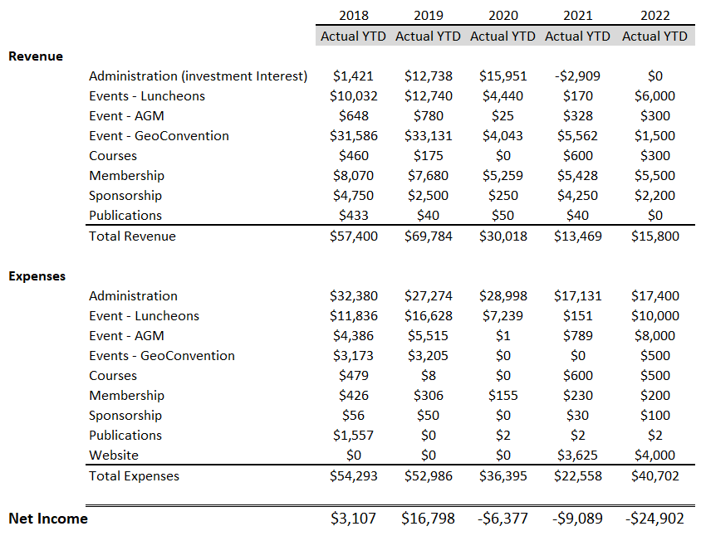
Financial implications
1 Decrease from investment income
2 Significant decrease in GeoConvention Revenue
3 Flat Membership Contributions
4 Significant Decline in Revenue
Unsustainable Financials

Slide 18
Where can I get more information?
A FAQ section has been added to our website here:
  https://www.cwls.org/wp-content/uploads/2022/06/CWLS-CSPG-FAQ.pdf
Information is available also on LinkedIn:
  Search LinkedIn for CWLS
The CSPG has posted a version of the FAQ’s for the edification of membership:
  https://www.cspg.org/
  https://www.cspg.org/common/Uploaded%20files/pdfs/documents/CSPGCWLSFAQs.pdf
Contact info@cwls.org for any questions or concerns

Slide 19
Special vote June 15-23
We will be conducting an online voting to determine whether we proceed with joining the CSPG
A YES vote of no less than 75% of the voting membership is required to proceed
You must be an active member and have paid your dues for the 2022 year to be eligible to vote
The CWLS is YOUR organization and YOUR vote matters!

Slide 20
A Yes vote*
The CWLS would be dissolved and cease to be a registered society under the Alberta Societies Act.
The CWLS would become one of 11 Technical Divisions under the CSPG umbrella.
Current CWLS members will have to register to be members with CWLS (unless already members)
Funds will be transferred “in-cash” to the CSPG and will be directed as per the MOU
The current CWLS Executive Board will continue until the transition is complete and the CWLS is dissolved (Fall, 2022)
Volunteers will be sought for positions within the Technical Committee
We will endeavor to continue to offer noon learning sessions and all other CWLS services while the transition take place
*Greater than 75% of voting membership

Slide 21
A NO VOTE*
In the event of a NO vote to dissolve the CWLS and join the CSPG:
The CWLS will continue as a registered society under the Alberta Societies Act.
  The Executive Board will be filled as per the current by-laws. Nominations will commence at the earliest opportunity
The financial revenue received from GeoConvention will decline as our partnership percentage is reduced from 10% to 3%.
The CWLS will retain the use of its logo and its social media platform.
All normal activities (lunch and learns) will continue as will all the resources currently available to members (Crain Lectures, Rw Catalog, Special Core Database), unless limited by funding availability.
*a NO vote or less than 75% of voting membership voting YES

